Slide 1
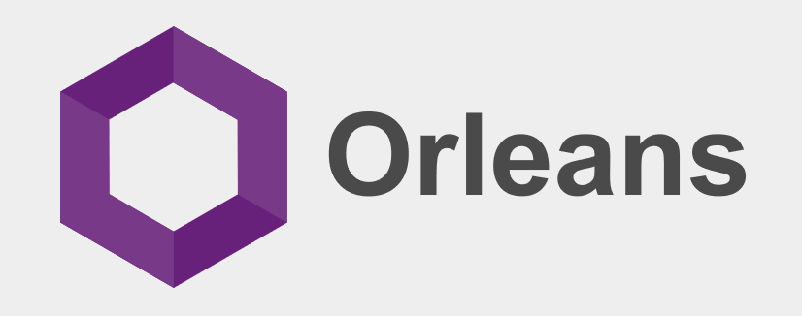
dotnet.github.io/orleans
David Gristwood
David.Gristwood@microsoft.com
@ScroffTheBad

Slide 2
Actor model
Model for concurrent computation circa 1973
Erlang early implementation, Akka, Service Fabric Reliable Actors framework
Improve performance via state in middle tier
Middle layer isn’t just wrapper round database CRUD calls
Reduce code complexity in complex systems
Actors always exist, virtually
Deadlock and re-entrant issues handled by system
Asynchronous communications between actors
Project “Orleans”
Developed by Microsoft Research, used in Xbox Halo 4 and 5

Slide 3

Orleans
Frontends
Middle Tier
Storage

Slide 4
Orleans
Frontends
Middle Tier
Cache
Storage

Slide 5
Orleans
Frontends
Stateful Middle Tier
Storage

Slide 6
Orleans
Frontends
Actor-based Middle Tier
Storage
Isolated, individually addressable entities that exchange messages
Notes:
Concurrency control
Horizontal calls

Slide 7
Orleans: Actor Model for the Cloud
Programming model
For all developers
Simple yet powerful
3x –10x less code
Scalable by default
No inherent bottlenecks
No single points of failure
Known best patterns & practices

Slide 8
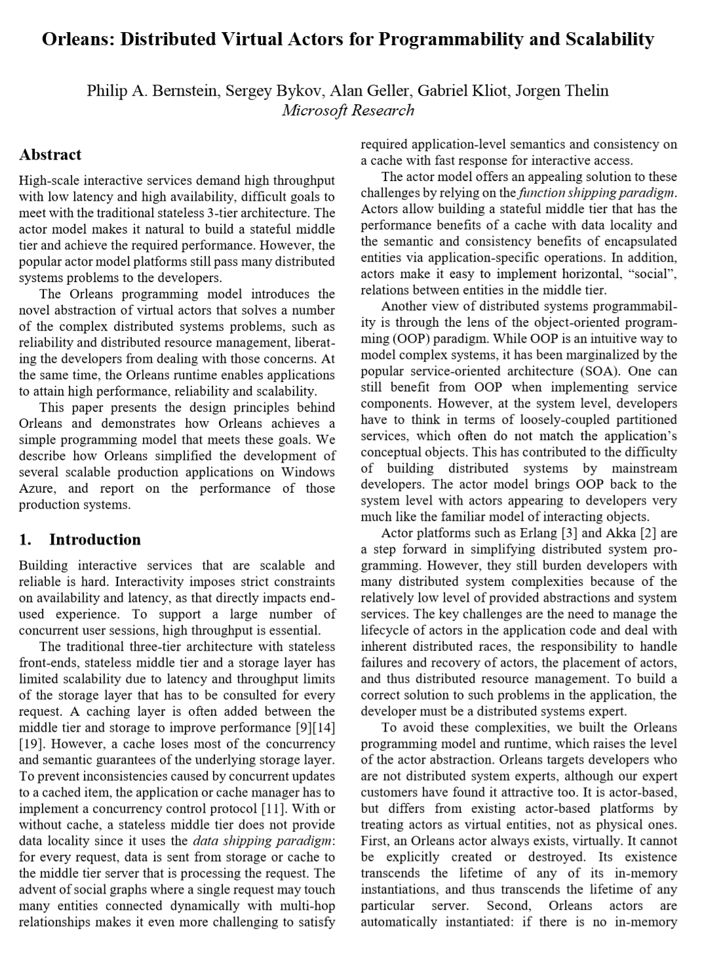
Grains: Virtual Actors
Actors always exist, virtually
Needn’t be created, looked up or deleted
Can call any actor at any time
Orleans Runtime performs heavy lifting
Transparently instantiates and GC’s actors
Routes requests & responses, invokes actors
Transparently recovers from server failures
Notes:
Erlang
Supervision trees

Slide 9
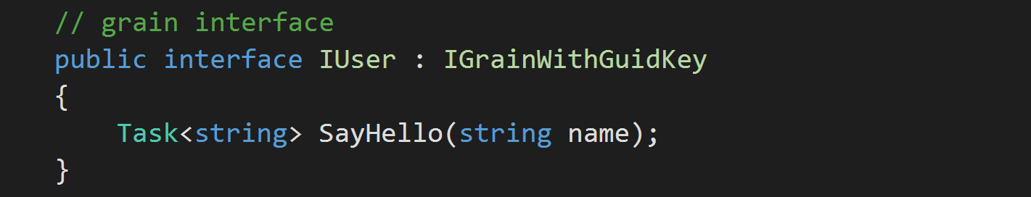
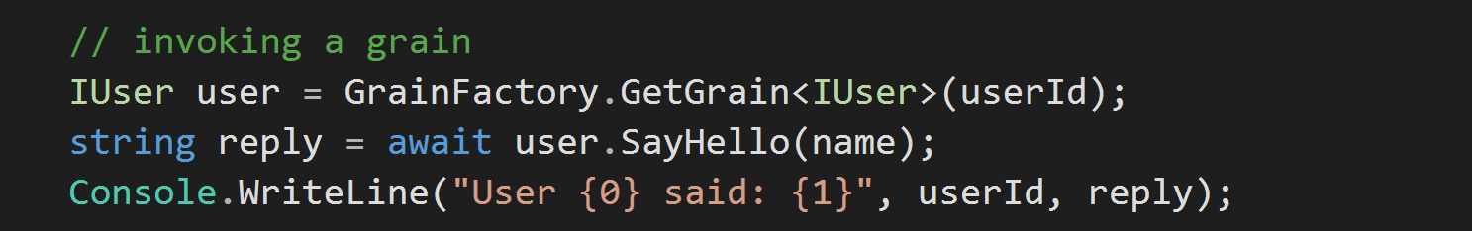
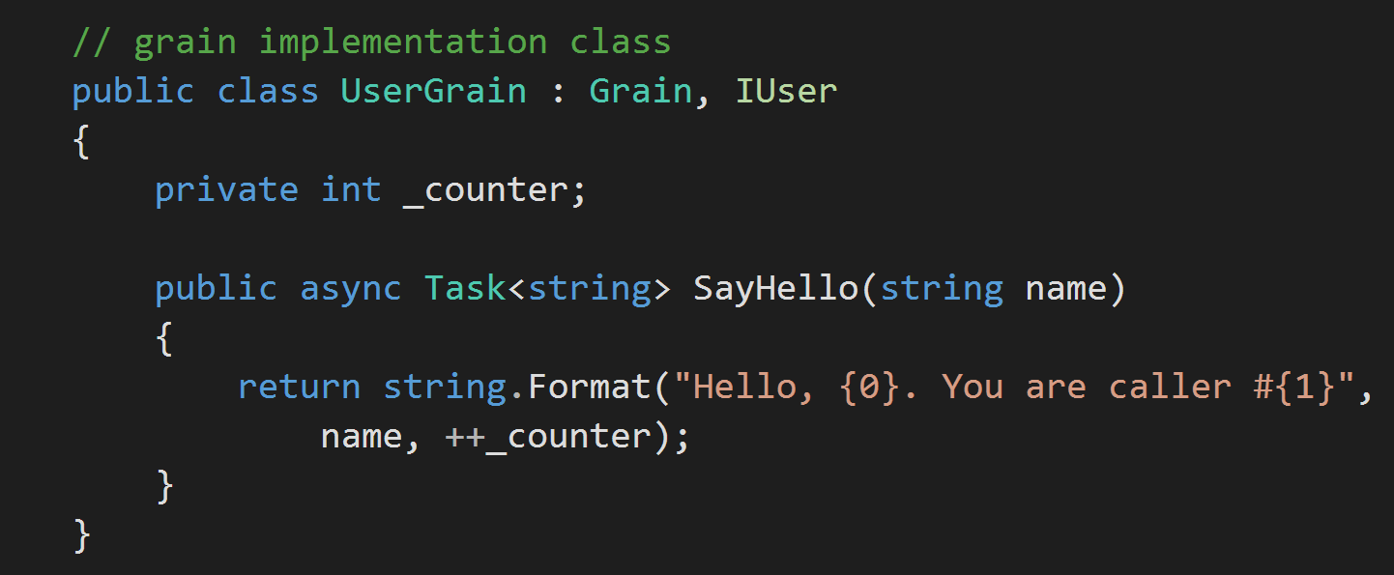
Single-threaded method call
Methods are always single-threaded
Notes:
Distributed C#
RPC

Slide 10
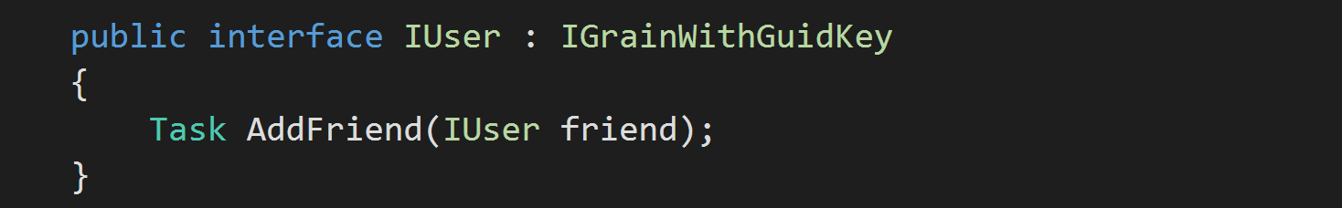

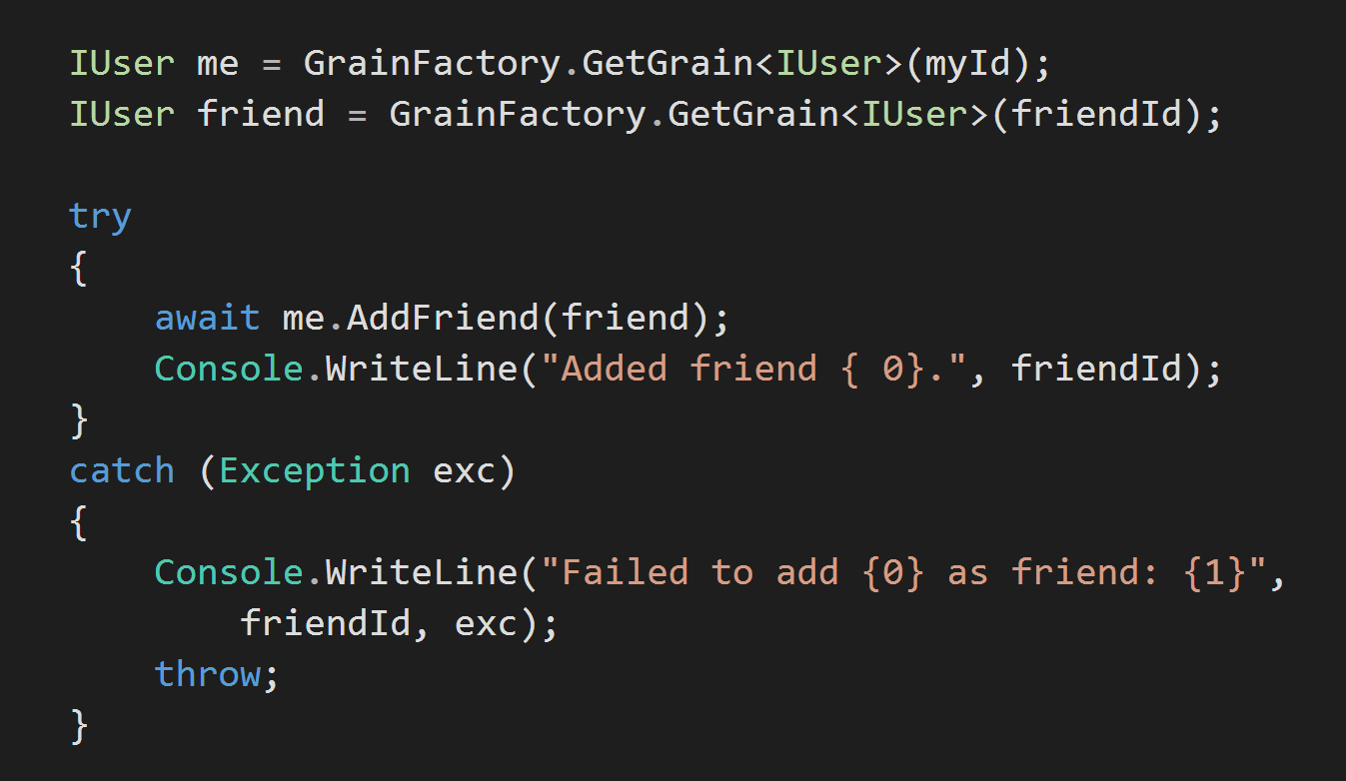
Grain reference as an argument
A
B
Distributed
asynchronous
try/catch
semantics!
Grain reference as an argument
C
Handle exceptions as if local
Notes:
Logical reference
Horizontal calls

Slide 11
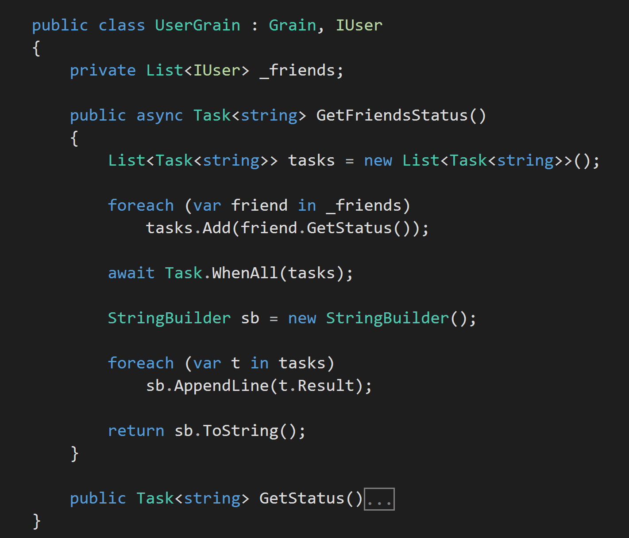
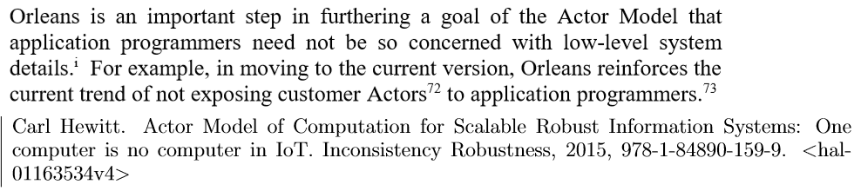
Promises and awaits
Ideal latency
…
Fan out
Join promises and await them
No multi-threading
No blocking of threads
Easy parallelism
Process results when ready
Notes:
MPI
Hewitt on Erlang

Slide 12
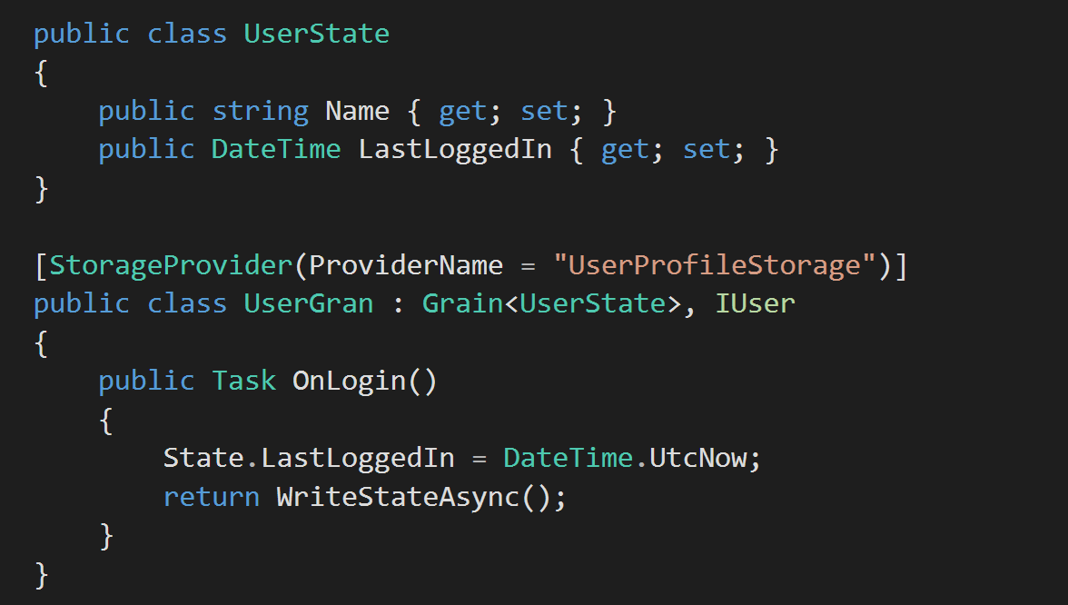
Declarative persistence
Property bag as state class
Included providers
Azure Table, Blob, SQL, in-memory (for development)
Community built
Redis, Mongo, DocDB, etc.
Link to config
Type argument
One line to save state
Notes:
Opt-in

Slide 13
Advance features in Orleans
Stateless workers
Re-entrant Grains
Interceptors
Observers
Timers and reminders

Slide 14

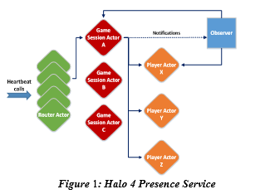
Orleans Video

Slide 15
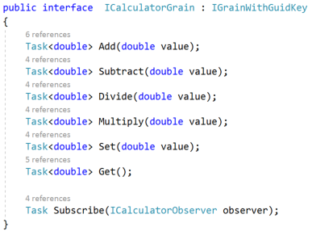
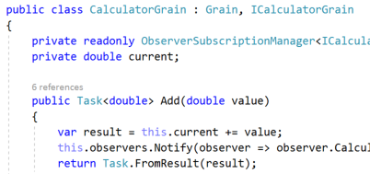
Orleans Demo
‘ServiceFabric’ sample
github.com/dotnet/orleans/tree/master/Samples/ServiceFabric
Deploys as Stateless Service in Service Fabric
Orleans can be hosted in any process, cloud or on-premises
Notes:
Check SF cluster is ok
In admin mode, VS build and start x64 debug to deploy
run cmd prompt at C:\WS\Orleans\orleans-master\Samples\ServiceFabric\Stateless\StatelessCalculatorClient\bin\x64\Debug
Run StatelessCalculatorClient get. Watch.
Break and then StatelessCalculatorClient + 100

Slide 16
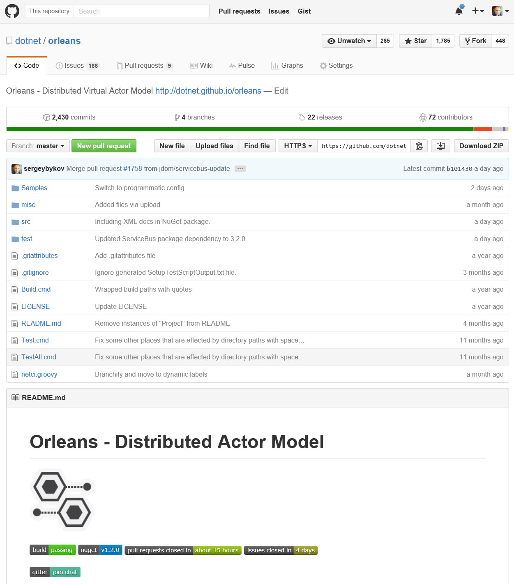
dotnet.github.io/orleans
Long and winding road
Started in Microsoft Research in 2009
First in production late 2011
First AAA deployment late 2012
Public preview 2014
Open-sourced (MIT) January 2015
Developed in the open on GitHub
Global community of contributors
Among top 20 of Microsoft OSS projects
Soon cross-platform with CoreCLR

Slide 17
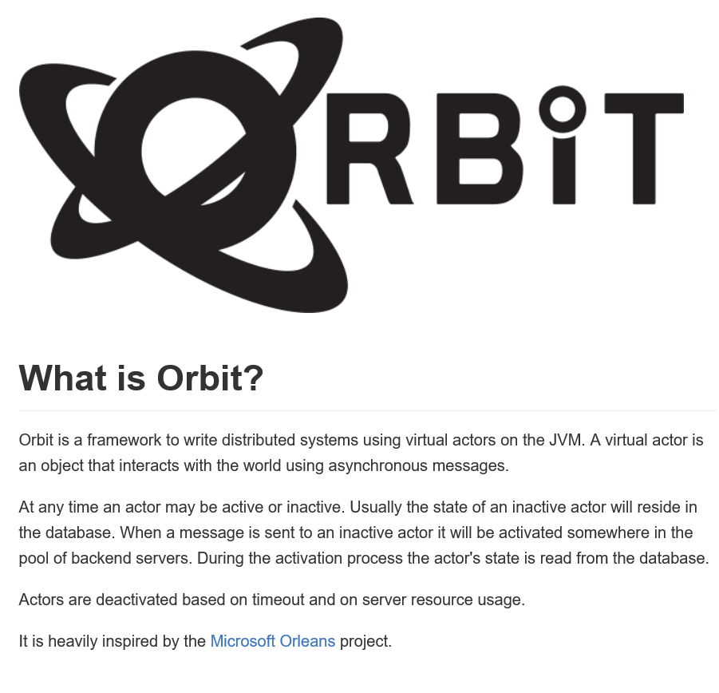
“Spread your wings and fly away”
Orleans runs anywhere
Can be hosted in any process
Cloud or on-premises
Azure, AWS, GCP, others
Plugins for MySQL, ZooKeeper, Consul
Open provider model
Soon cross-platform
Imitation is sincerest form of flattery
Orleans has a JVM clone
Attempt to implement Virtual Actors in Go
Notes:
Lightbend Lagom

